Slide 1

The Future of Online Shopping
Adwaid Manoj, Adithya Vinod, Ajay Das, Anamika S
Notes:
1

Slide 2
Research Paper Analysis: E-Commerce Advancements
Online Product Decision Support Using Sentiment Analysis and Fuzzy Cloud-based Multi-Criteria Model
Static ML-Based Usability & Security Analysis in E-Commerce
Sentiment Analysis in E-Commerce Platforms: Review of Techniques & Future Directions
Hybrid Recommendation Systems in E-Commerce: A Systematic Review
Impact of Computer Applications on Cross-Border E-Commerce Performance
OntoCommerce: Ontology & Sequential Pattern Mining for E-Commerce Recommendations
End-Cloud AI Framework for E-Commerce Customer Service
E-Commerce Image Enhancement via Instance Segmentation & Background Replacement

Slide 3
Online Product Decision Support Using Sentiment Analysis and Fuzzy Cloud-based Multi-Criteria Model - Yang Z., Li Q., Vincent C., Xu B., Gupta S.
Methodology
BiLSTM-CRF, sentiment analysis, and K-means for product attribute mining
q-Rung Orthopair Fuzzy Cloud (q-ROFC) for sentiment error analysis
Multi-platform decision framework using fuzzy set theory
Future Scope
Expansion to other domains
Real-time consumer behavior analysis

Slide 4
ADVANTAGES
Enhanced accuracy in mining product sentiments.
Combines cross-platform reviews for better decision-making.
DISADVANTAGES
Limited focus on real-time scalability.
Possible bias from uneven review distribution and fake reviews.

Slide 5
2. Static ML-Based Usability & Security Analysis in E-Commerce -Kumar B., Roy S., Singh K.U., Pandey S.K., Kumar A., et al.
Methodology
AHP, VIKOR, TOPSIS for decision-making
User surveys for usability assessments
Security checks via online malware scanners
Future Scope
Real-time adaptive evaluation
Global e-commerce platform expansion

Slide 6
ADVANTAGES
Combines usability and security metrics effectively
Provides insights into e-commerce website performance in rural regions.
DISADVANTAGES
Limited sample size and geographic focus..
Does not address dynamic usability trends.

Slide 7
3. Sentiment Analysis in E-Commerce Platforms: Review of Techniques & Future Directions
- Huang H., Asemi Zavareh A., Mustafa M.B.
Methodology
Reviewed 54 studies on sentiment analysis in e-commerce
Explored ML (SVM, Naive Bayes) & DL (RNN, LSTM, BERT) techniques
Categorized data sources (Amazon, Twitter, IMDB) & research gaps
Future Scope
Universal models for multi-language & cross-domain analysis
Enhanced implicit aspect recognition & sarcasm detection

Slide 8
ADVANTAGES
Combrehensive comparison of machine learning and deep learning techniques
Identified future research directions
DISADVANTAGES
Limited focus on non-English language datasets
Lacks experimental validation of proposed research directions.

Slide 9
4. Hybrid Recommendation Systems in E-Commerce: A Systematic Review
-Bodduluri K.C., Palma F., Kurti A., Jusufi I., Löwenadler H.
Methodology
Reviewed 48 studies on hybrid recommendation systems
Used data synthesis, quality assessment, and trend analysis
Future Scope
AI integration, explainable models, multimodal data fusion, standardized metrics

Slide 10
ADVANTAGES
Improves recommendation accuracy, scalability, robustness, and personalization.
DISADVANTAGES
Persistent issues include cold start problems, data sparsity, and complexity in evolving user behavior.

Slide 11
5. Impact of Computer Applications on Cross-Border E-Commerce Performance
-Jin L., Chen L.
Methodology
Genetic Algorithm & CNNs for performance optimization
Focused on efficiency, predictive accuracy, and customer satisfaction
Future Scope
Blockchain for secure transactions, AI for personalization, ethical AI for privacy & security

Slide 12
ADVANTAGES
Enhances operational efficiency, predictive accuracy, and customer satisfaction by leveraging data analytics and machine learning models.
DISADVANTAGES
Challenges include computational complexity ,sensitivity to parameter settings ,and regulatory compliance issues

Slide 13
6. OntoCommerce: Ontology & Sequential Pattern Mining for E-Commerce Recommendations
-Mustafa G. et al.
Methodology
Hybrid recommender system using ontology for domain knowledge & Sequential Pattern Mining (SPM) for purchase patterns
Future Scope
Extend to other domains & improve scalability

Slide 14
ADVANTAGES
Provides highly personalised recommendations
Tackles cold-start and data sparsity issues effectively
DISADVANTAGES
Dependency on accurate ontology construction
High computational complexity

Slide 15
7. End-Cloud AI Framework for E-Commerce Customer Service
- Teng L., Liu Y., Liu J., Song L.
Methodology
Integrates cloud-based large models with end-device AI for real-time, privacy-preserving customer support
Future Scope
Expand deployment across industries with better optimization

Slide 16
ADVANTAGES
Combines local model efficiency with cloud model intelligence
Ensures privacy and adaptability
DISADVANTAGES
Requires substantial initial setup
High training costs

Slide 17
8. E-Commerce Image Enhancement via Instance Segmentation & Background Replacement
-Gao Q., Hu H., Liu W.
Methodology
Uses Fast-SAM segmentation, background replacement, & shadow generation for product image enhancement
Future Scope
Expand dataset diversity & apply to fields like medical imaging & artwork analysis

Slide 18
ADVANTAGES
Improves product visual appeal and recognition accuracy
Maintains computational efficiency
DISADVANTAGES
Limited generalizability to diverse product datasets.
Computational overhead for real-time applications

Slide 19
ABSTRACT
The Online Shopping Platform (OSP) is an advanced e-commerce solution designed to provide a seamless and personalized shopping experience. With a wide range of product categories like electronics, fashion, and groceries, OSP offers users the ability to browse, purchase, and manage products effortlessly. Key features include personalized recommendations based on user preferences, advanced search and filter options, secure payment methods, and real-time order tracking from purchase to delivery. Customers can also read reviews, compare products, create wishlists, and receive notifications about exclusive deals and discounts. OSP prioritizes security with a robust checkout process and supports multiple payment methods for convenience. Its intuitive interface ensures easy navigation, while tools like product comparison and customer reviews empower users to make informed decisions. By integrating tailored recommendations, secure transactions, and enhanced usability, OSP redefines online shopping, providing a safe, convenient, and engaging experience for all users.

Slide 20
System Architecture Requirements
Frontend
ReactJS will be used for the frontend, providing a responsive and interactive user interface
Backend
Node.js with Express will handle the backend logic, including API endpoints and data processing.
Database
MongoDB will serve as the database, providing a flexible and scalable data storage solution.
Third-Party
We will utilize a third-party payment gateway for secure transaction processing and notifications for communication with users.

Slide 21
REQUIREMENTS
HARDWARE REQUIREMENTS | SOFTWARE REQUIREMENTS
PROCESSOR - Intel i3/i5/i7 processors offer sufficient performance for this application. | WINDOWS - Windows 8 or above is supported.
RAM - 8GB of RAM is recommended, with 16GB providing optimal performance. | LINUX - Linux distributions are supported.
STORAGE - A 256GB HDD is sufficient, but an SSD will significantly improve performance. | MAC - Mac operating systems are compatible.
NETWORK - A high-speed internet connection is essential for smooth operation.

Slide 22
Project Plan
Plan | Given Date | Expected Date | Status
Project Initialization | 19/12/24 |  | completed
Literature Review | 09/01/25 |  | completed
Abstract | 23/01/25 |  | completed
SRS | 30/01/25 |  | completed
Design Document | 06/01/25 |  | completed
Test Plan | 20/02/25
First Plan | 27/02/25 |  | completed
Second Plan | 27/02/25
Project Report | 27/03/25
Final PPT | 03/34/25

Slide 23
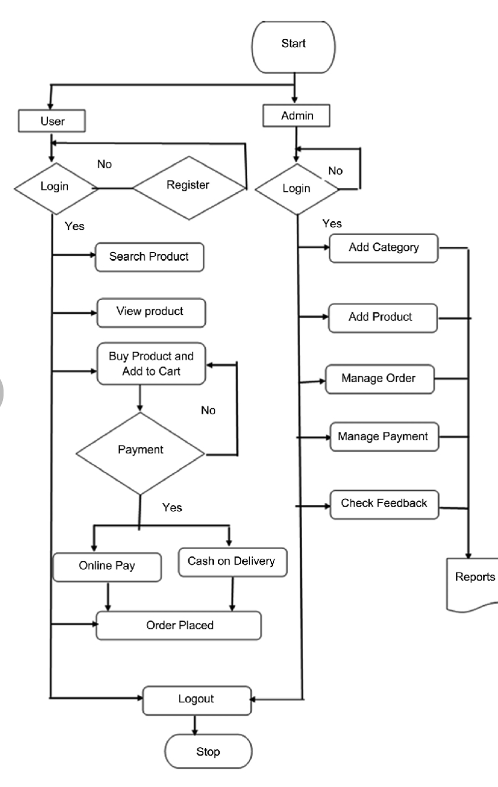
FLOW CHART

Slide 24
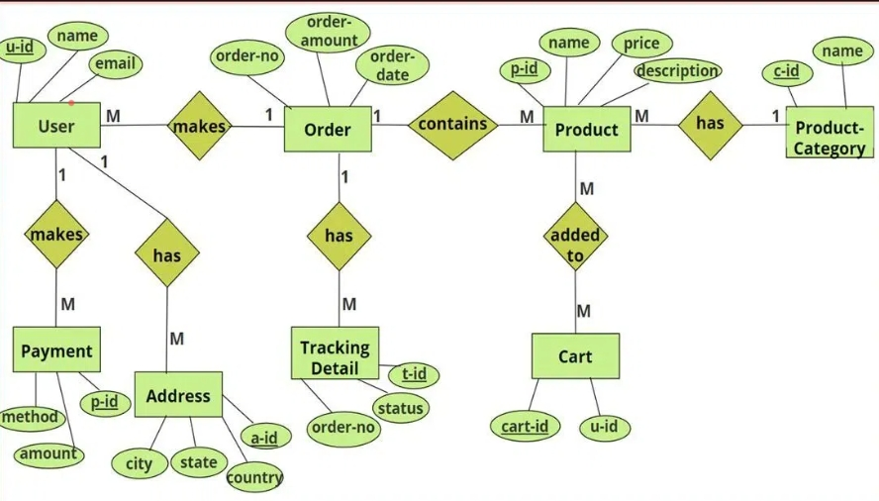
ER DIAGRAM

Slide 25
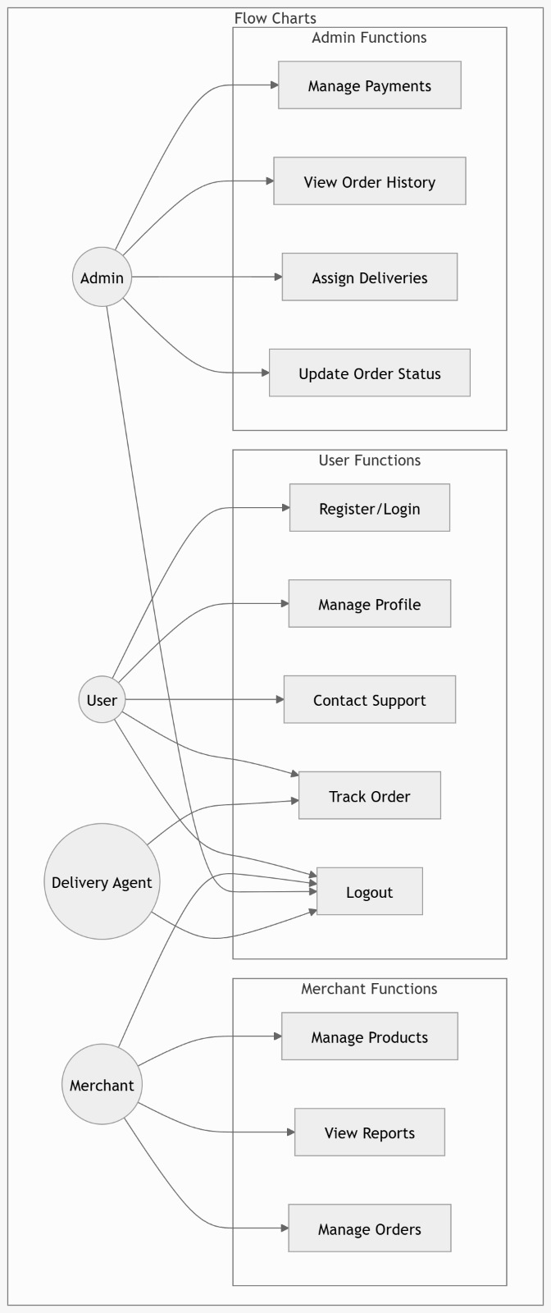
USE CASE DIAGRAM

Slide 26
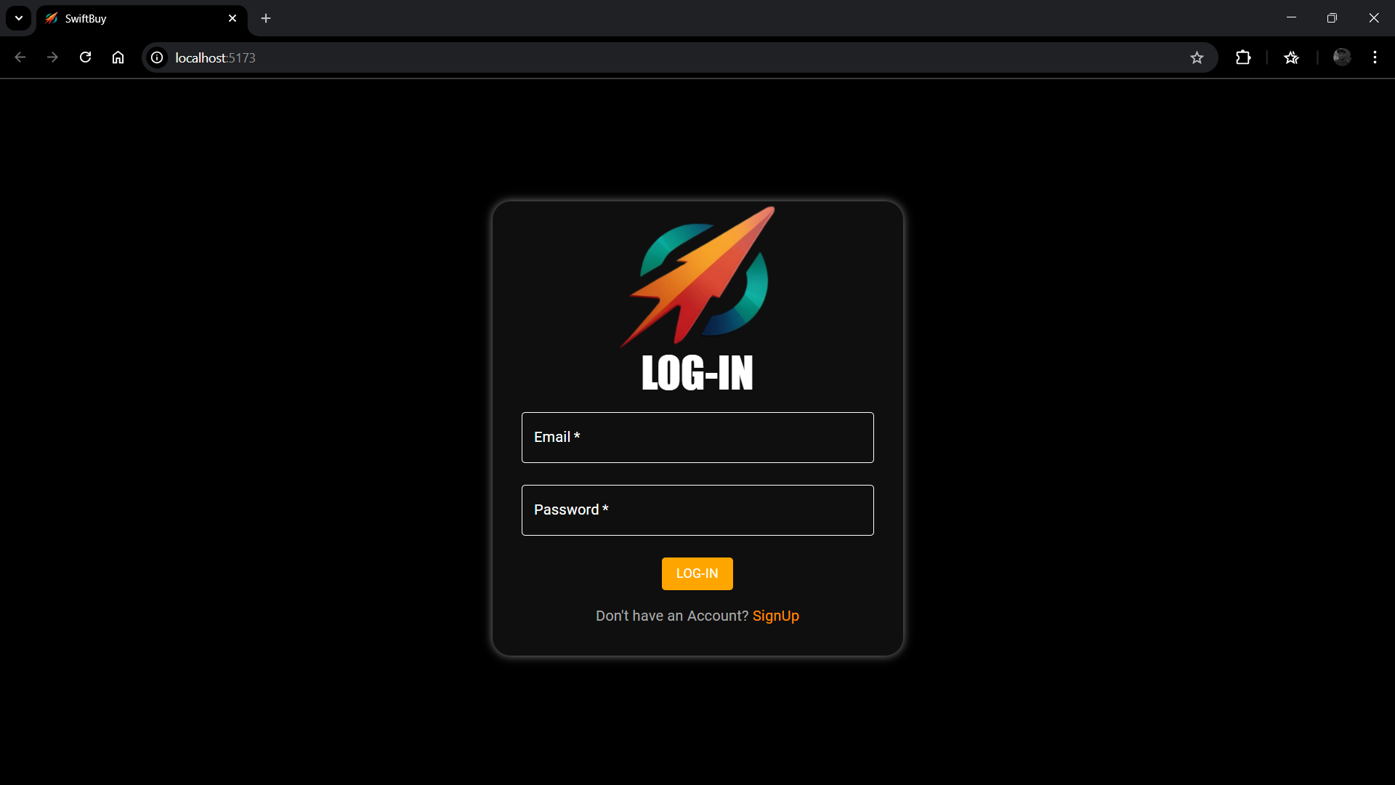
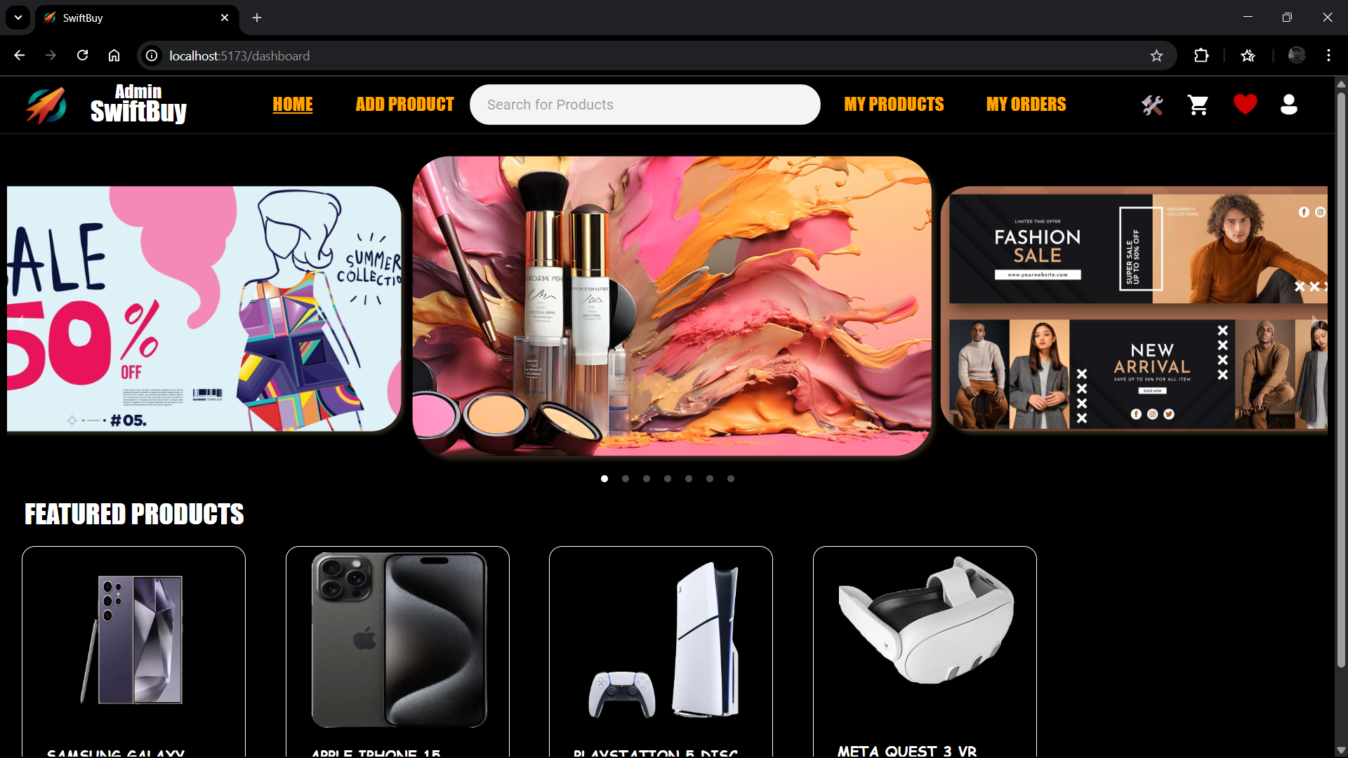
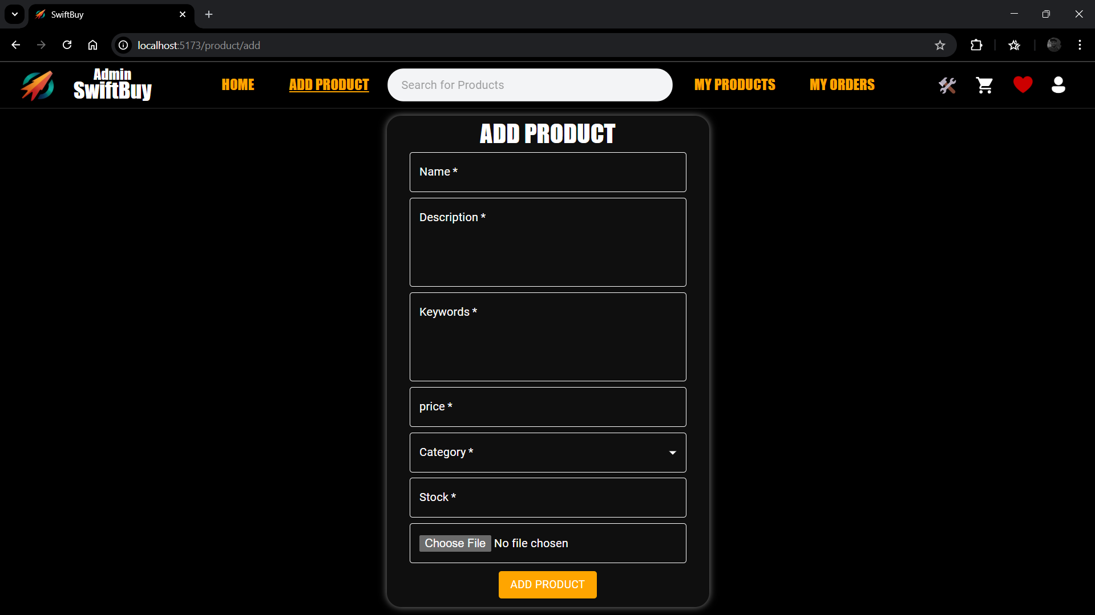
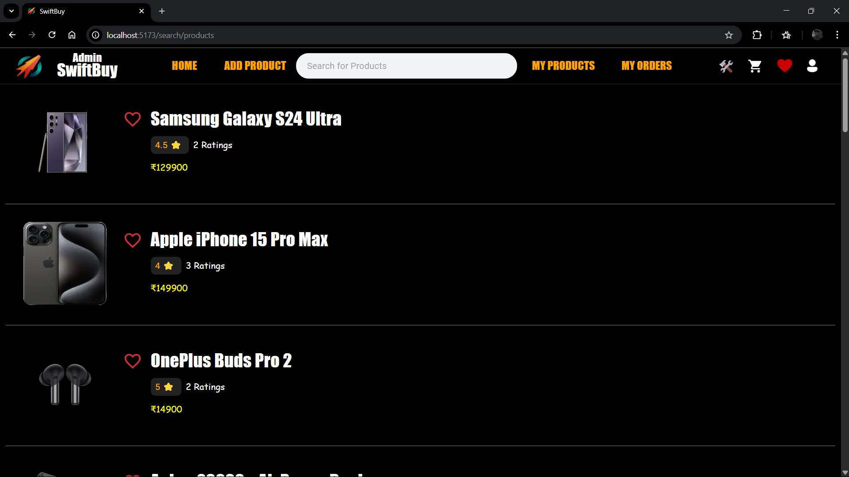
OUTPUT

Slide 27
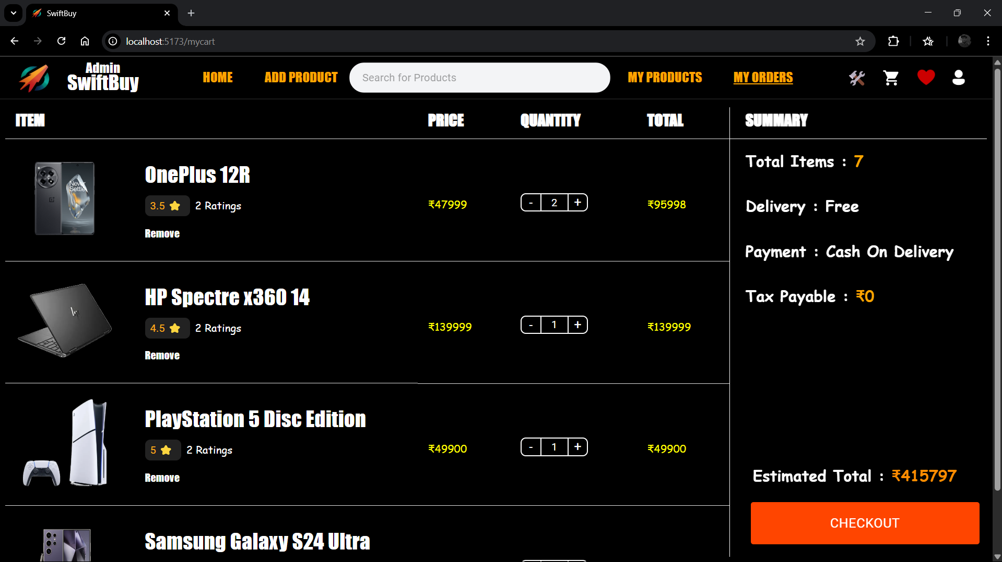
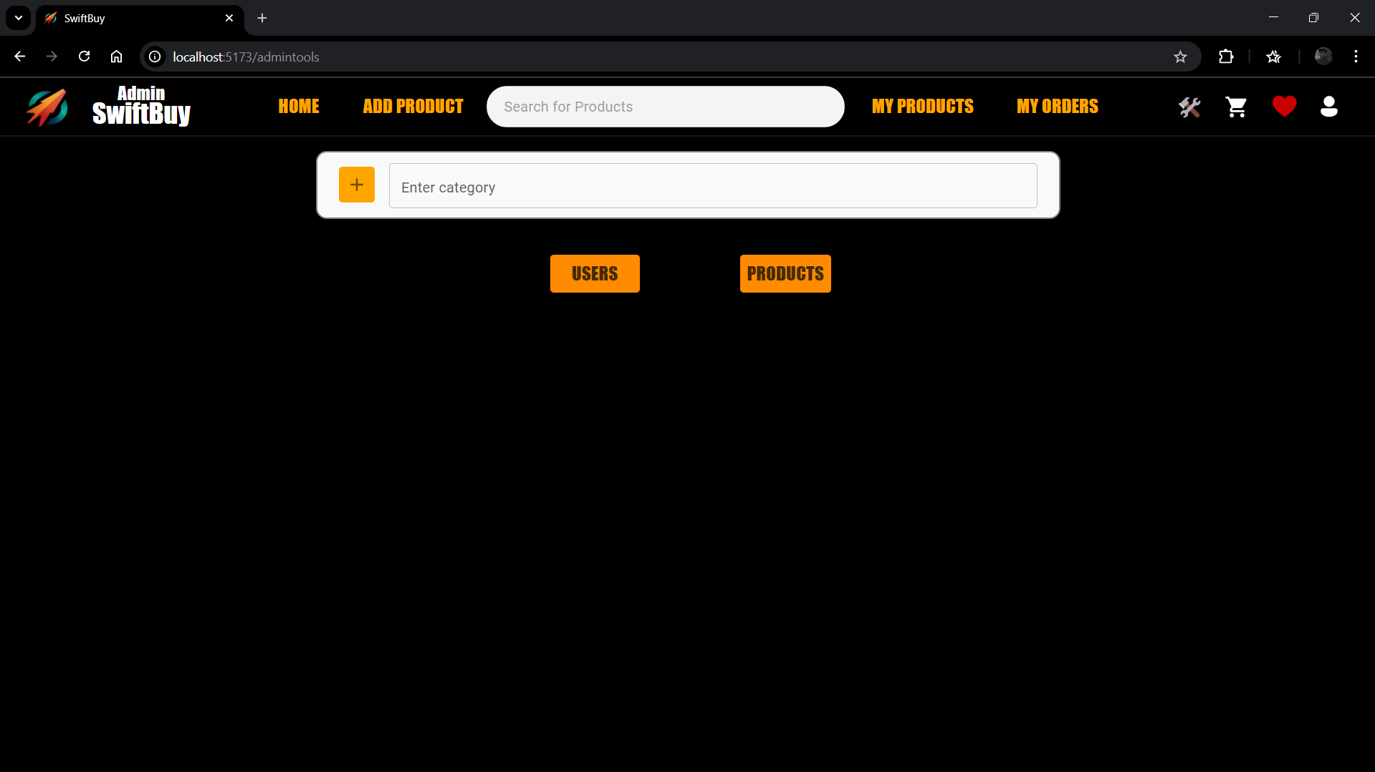
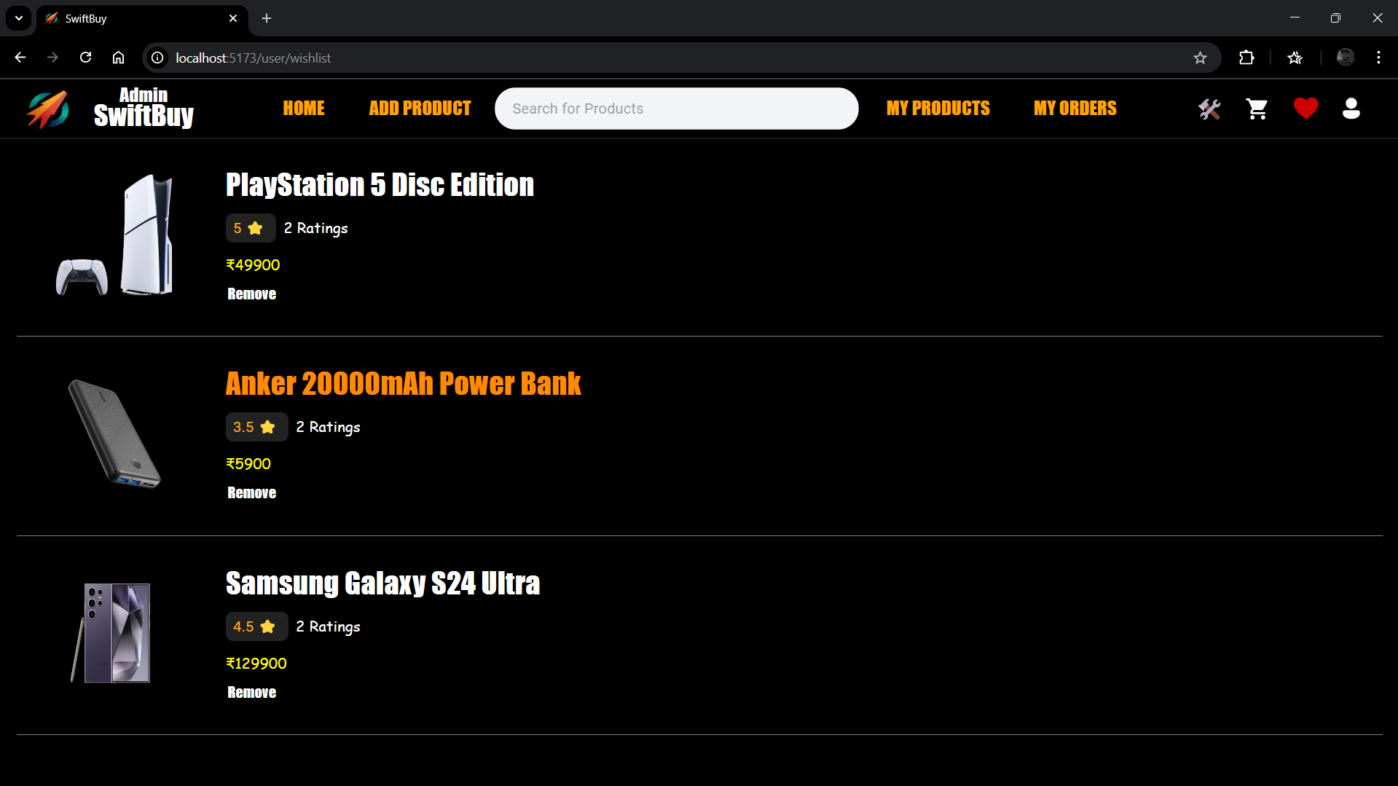
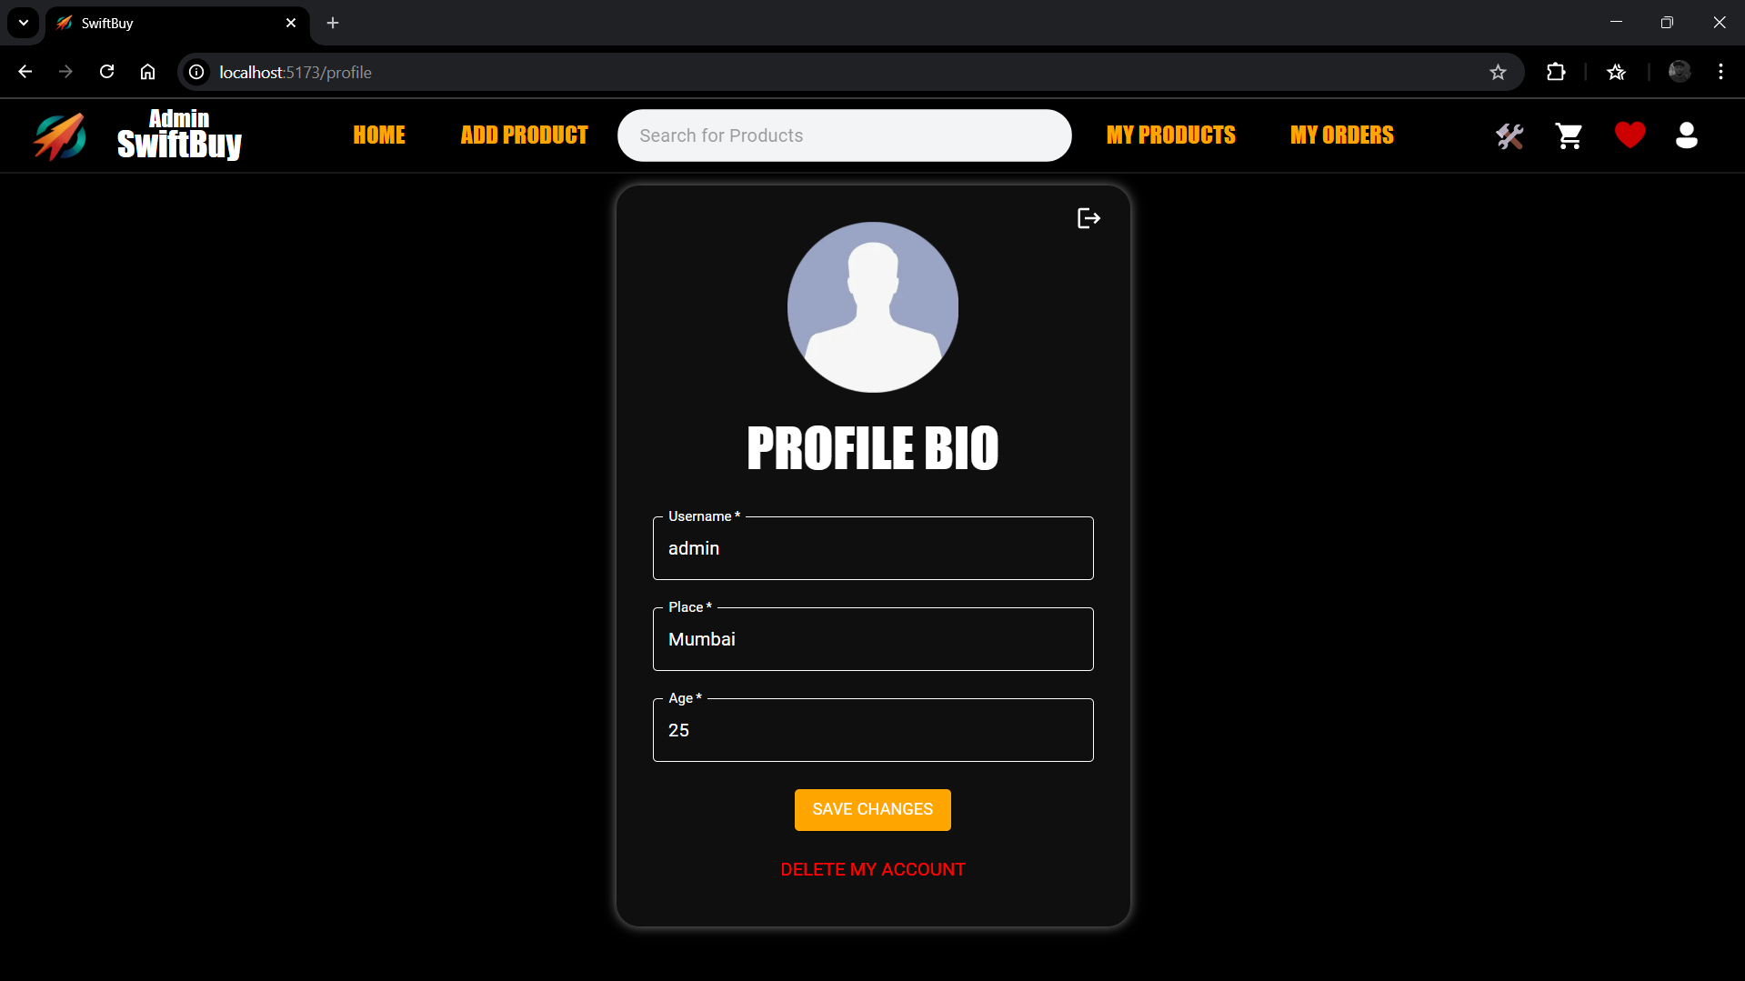

Slide 28
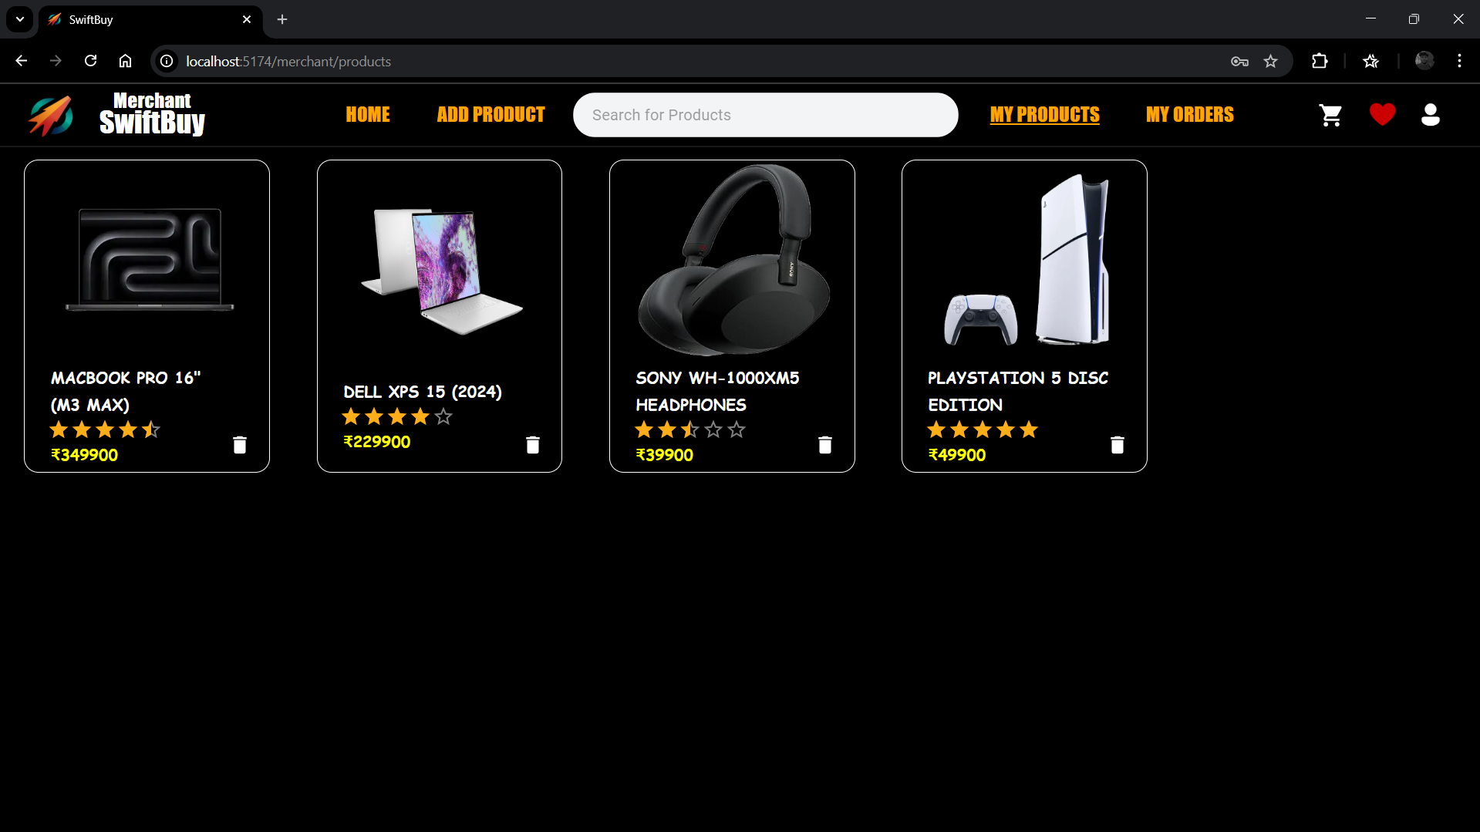
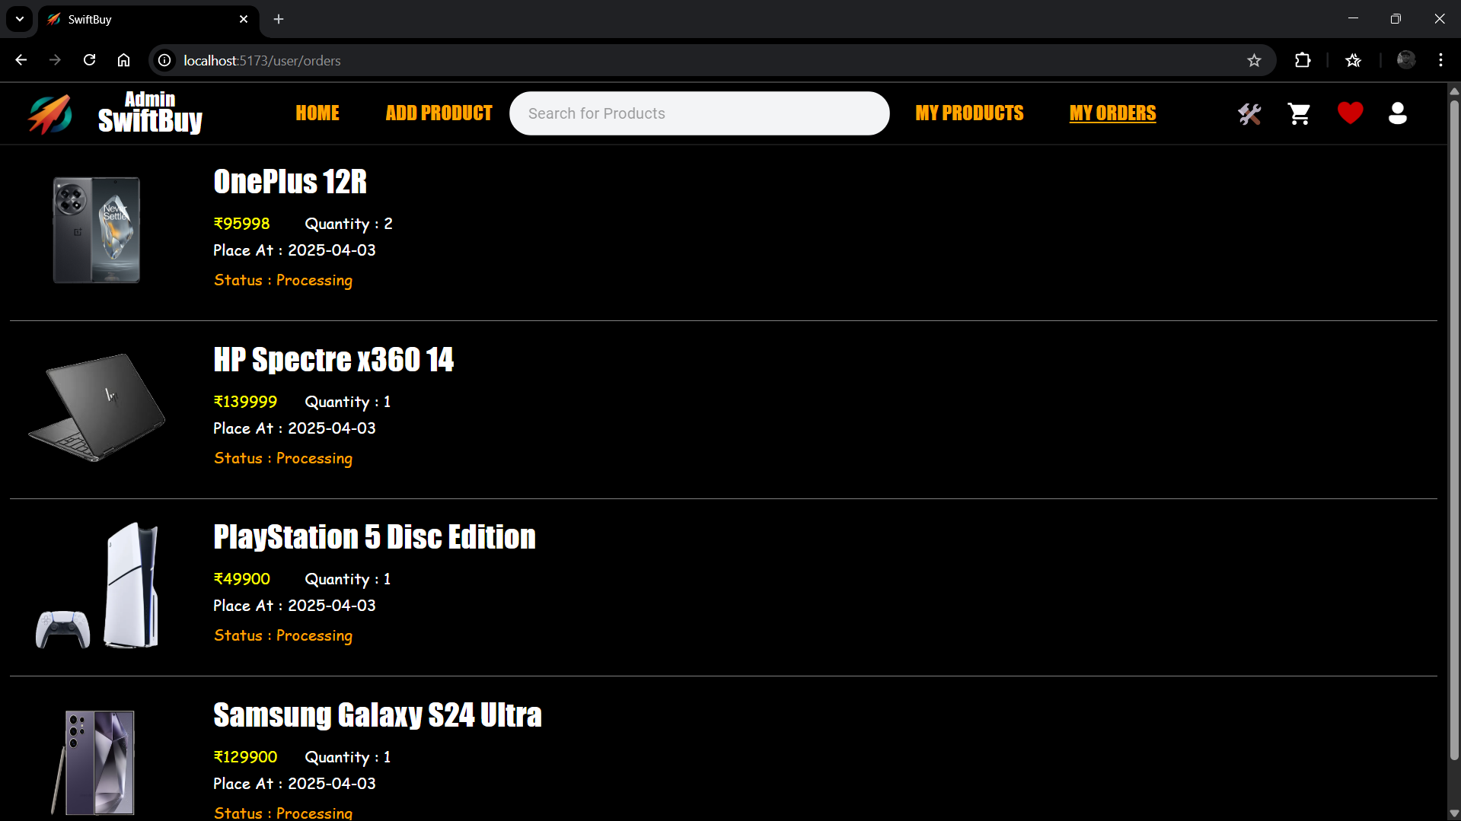

Slide 29
CONCLUSION
The Online Shopping Platform (OSP) successfully delivers a seamless, secure, and user-friendly e-commerce experience. By incorporating personalized recommendations, secure payment options, and real-time order tracking, OSP enhances convenience and reliability for users. Its advanced search, filtering, and product comparison features empower customers to make informed purchasing decisions. Additionally, intuitive navigation, customer reviews, and wishlist functionalities contribute to an engaging shopping journey. With a strong focus on security and usability, OSP redefines online shopping, making it an efficient and enjoyable platform for users seeking a comprehensive and personalized retail experience.

Slide 30
THANK YOU

